Slide 1




Fortifying Industrial Control Systems: A Deep Dive into Evaluating Cryptographic Implementations
By Nick Miles
OCTOBER 21-24, 2024 | ATLANTA

Slide 2



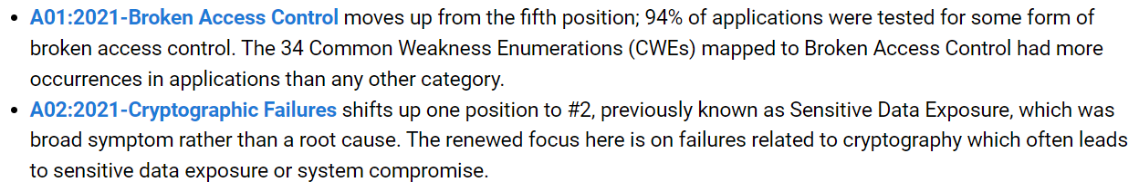
Cryptography
“A security system is only as strong as its weakest link.”
- Cryptography Engineering
2024 SecurityWeek ICS Cybersecurity Conference

Slide 3

Agenda
Cryptography Basics
Block / Stream Ciphers
Hashing Algorithms
Digital Signatures / PKI
Key Exchange
TLS
Case Studies
Best Practices and Conclusions
Passwords and Keys
2FA

Slide 4

Ciphers
Block Ciphers
AES (Rijndael)
Block Size: 128 bit
Key Sizes: 128, 192, 256 bits
3DES
Block Size: 64 bit
Key Sizes: 112 or 168 bits
Stream Ciphers
ChaCha20
State Size: 512 bit
Key Sizes: 128, 256 bits
RC4
State Size: 2064 bits
Key Sizes: 40-2048 bits
Block Cipher
Plaintext
Cipher
Ciphertext
one block
Cipher
Stream Cipher
keystream
Plaintext
Ciphertext
one byte
xor

Slide 5
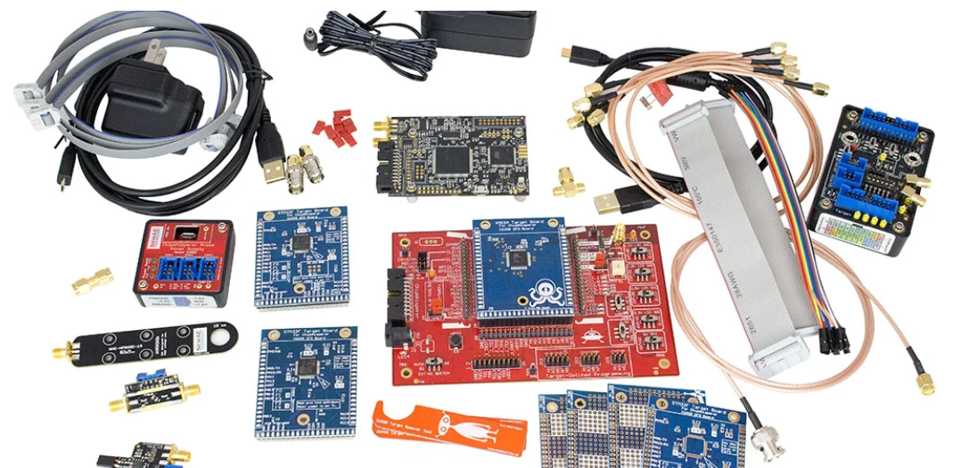
Side Channel Attacks
ChipWhisperer – https://www.newae.com

Slide 6
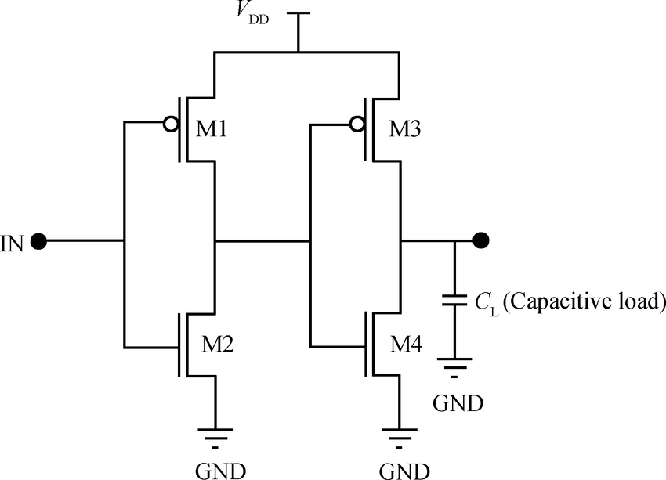
CMOS Data Bus
Hamming Weight Swings
Power Consumption
11111111 -> 00000000
11111110 -> 11111111
(8)
(1)

Slide 7
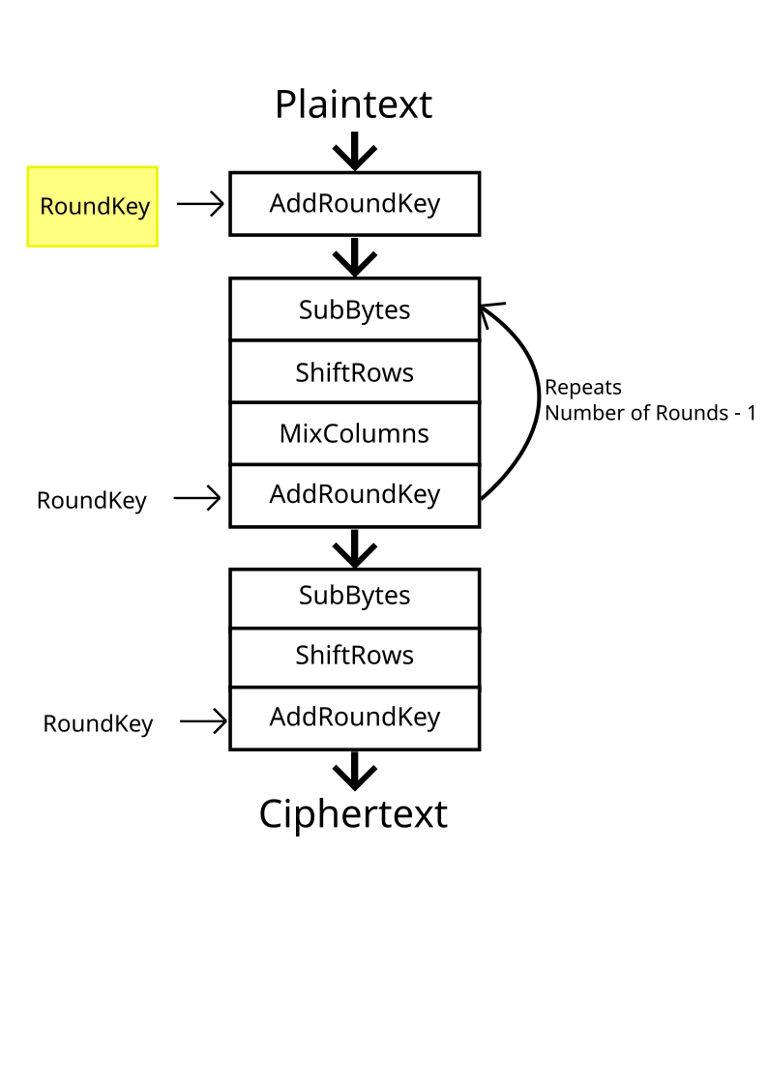
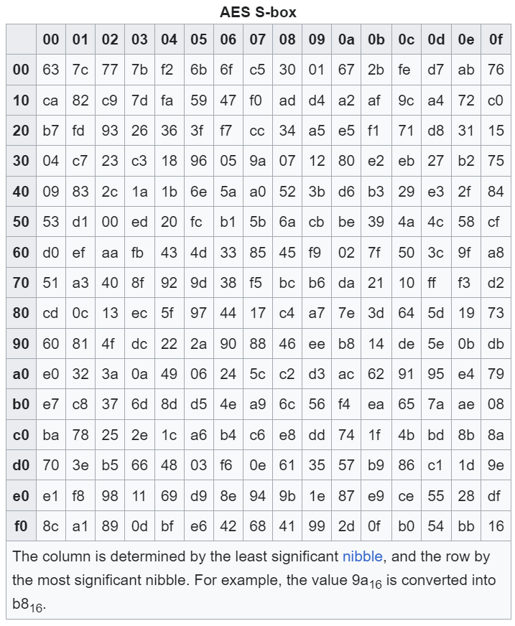
AES
https://en.wikipedia.org/wiki/Rijndael_S-box

Slide 8
Correlation Power Analysis Attack
Input Byte (first byte, first block) | Key Guess | AddRoundKey | SubBytes | Hamming Weight | Power Trace
0xF1 | 0x00 | 0xF1 | 0xA1 | 3
0x13 | 0x00 | 0x13 | 0x7D | 6
0xE2 | 0x00 | 0xE2 | 0x98 | 3
0x83 | 0x00 | 0x83 | 0xEC | 5
… | … | … | … | … | …

Slide 9
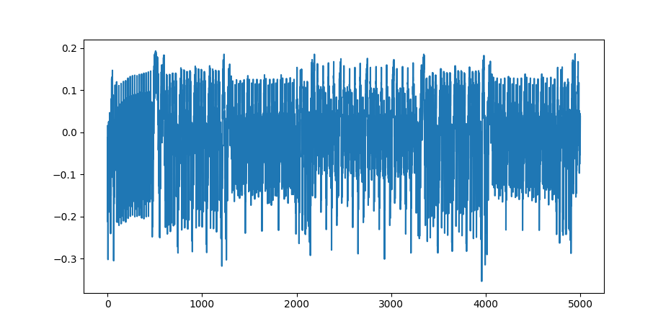
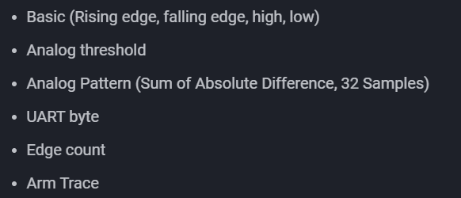
Correlation Power Analysis Attack
Triggers (ChipWhisperer Husky)

Slide 10
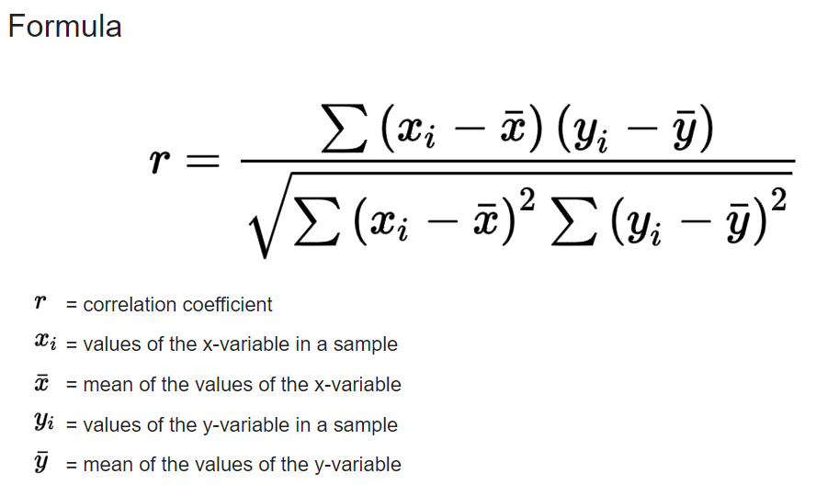
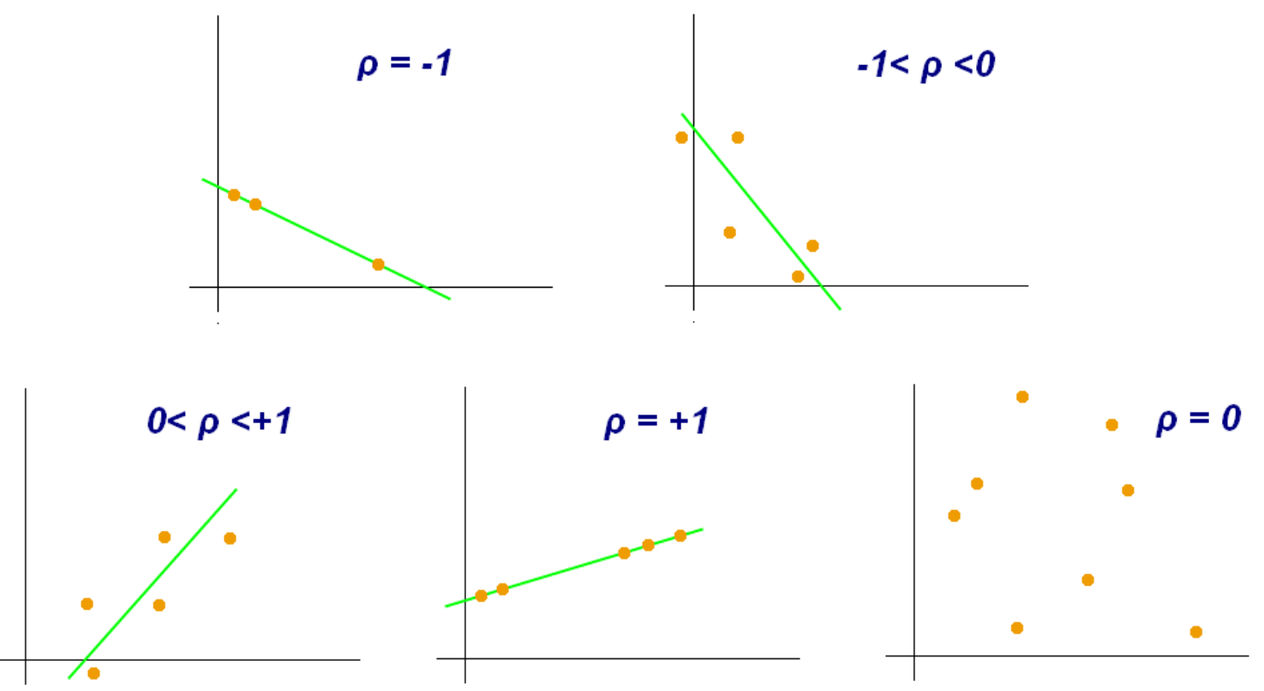
y
y
x
x
y
y
y
x
x
x

Slide 11
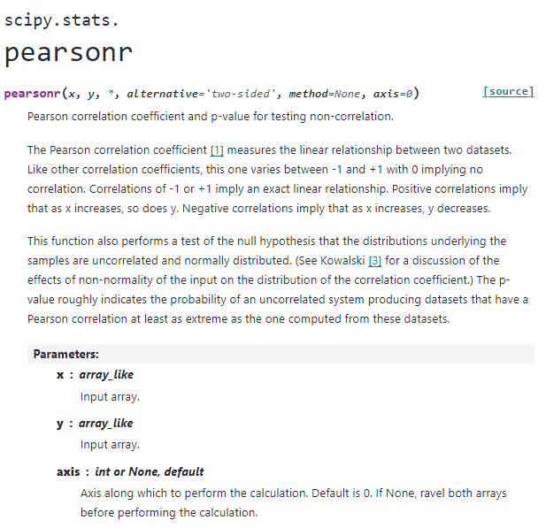

Slide 12
Correlation Power Analysis Attack
Input Byte (first byte, first block) | Key Guess | AddRoundKey | SubBytes | Hamming Weight | Power Trace
0xF1 | 0x00 | 0xF1 | 0xA1 | 3
0x13 | 0x00 | 0x13 | 0x7D | 6
0xE2 | 0x00 | 0xE2 | 0x98 | 3
0x83 | 0x00 | 0x83 | 0xEC | 5
… | … | … | … | … | …
Total times running pearsonr: 255*16*[number of data points in trace]

Slide 13
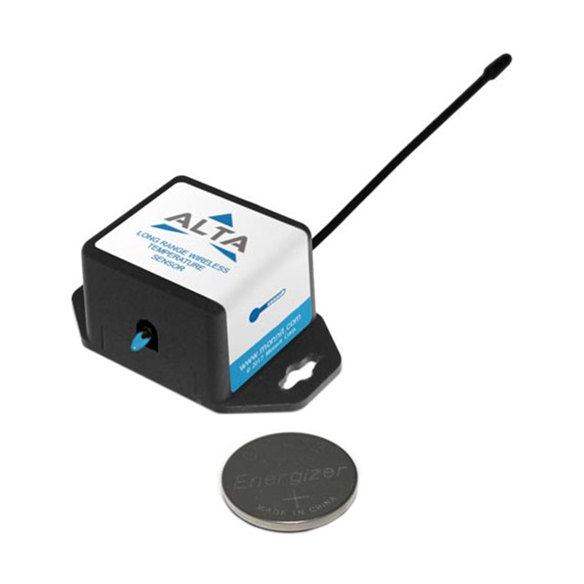
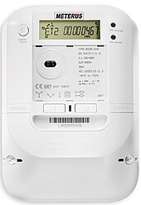
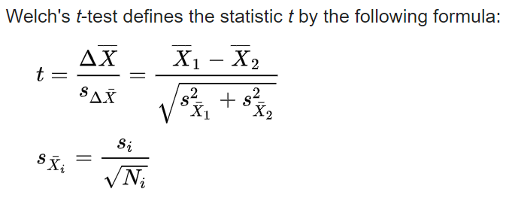
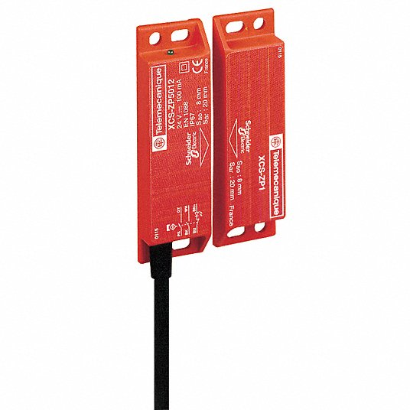

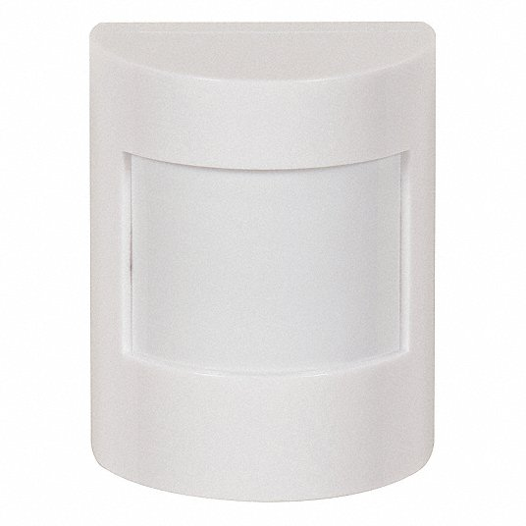
Applicability and Mitigation
TVLA (Test Vector Leakage Assessment)
PP-0084 (Secure IC)
JHAS (Joint Hardware Attack Subgroup)
JIL (score < 31 points, no attack path)
ISO 19790
FIPS 140-3
ISO 17825
ISO/SAE 21434

Slide 14
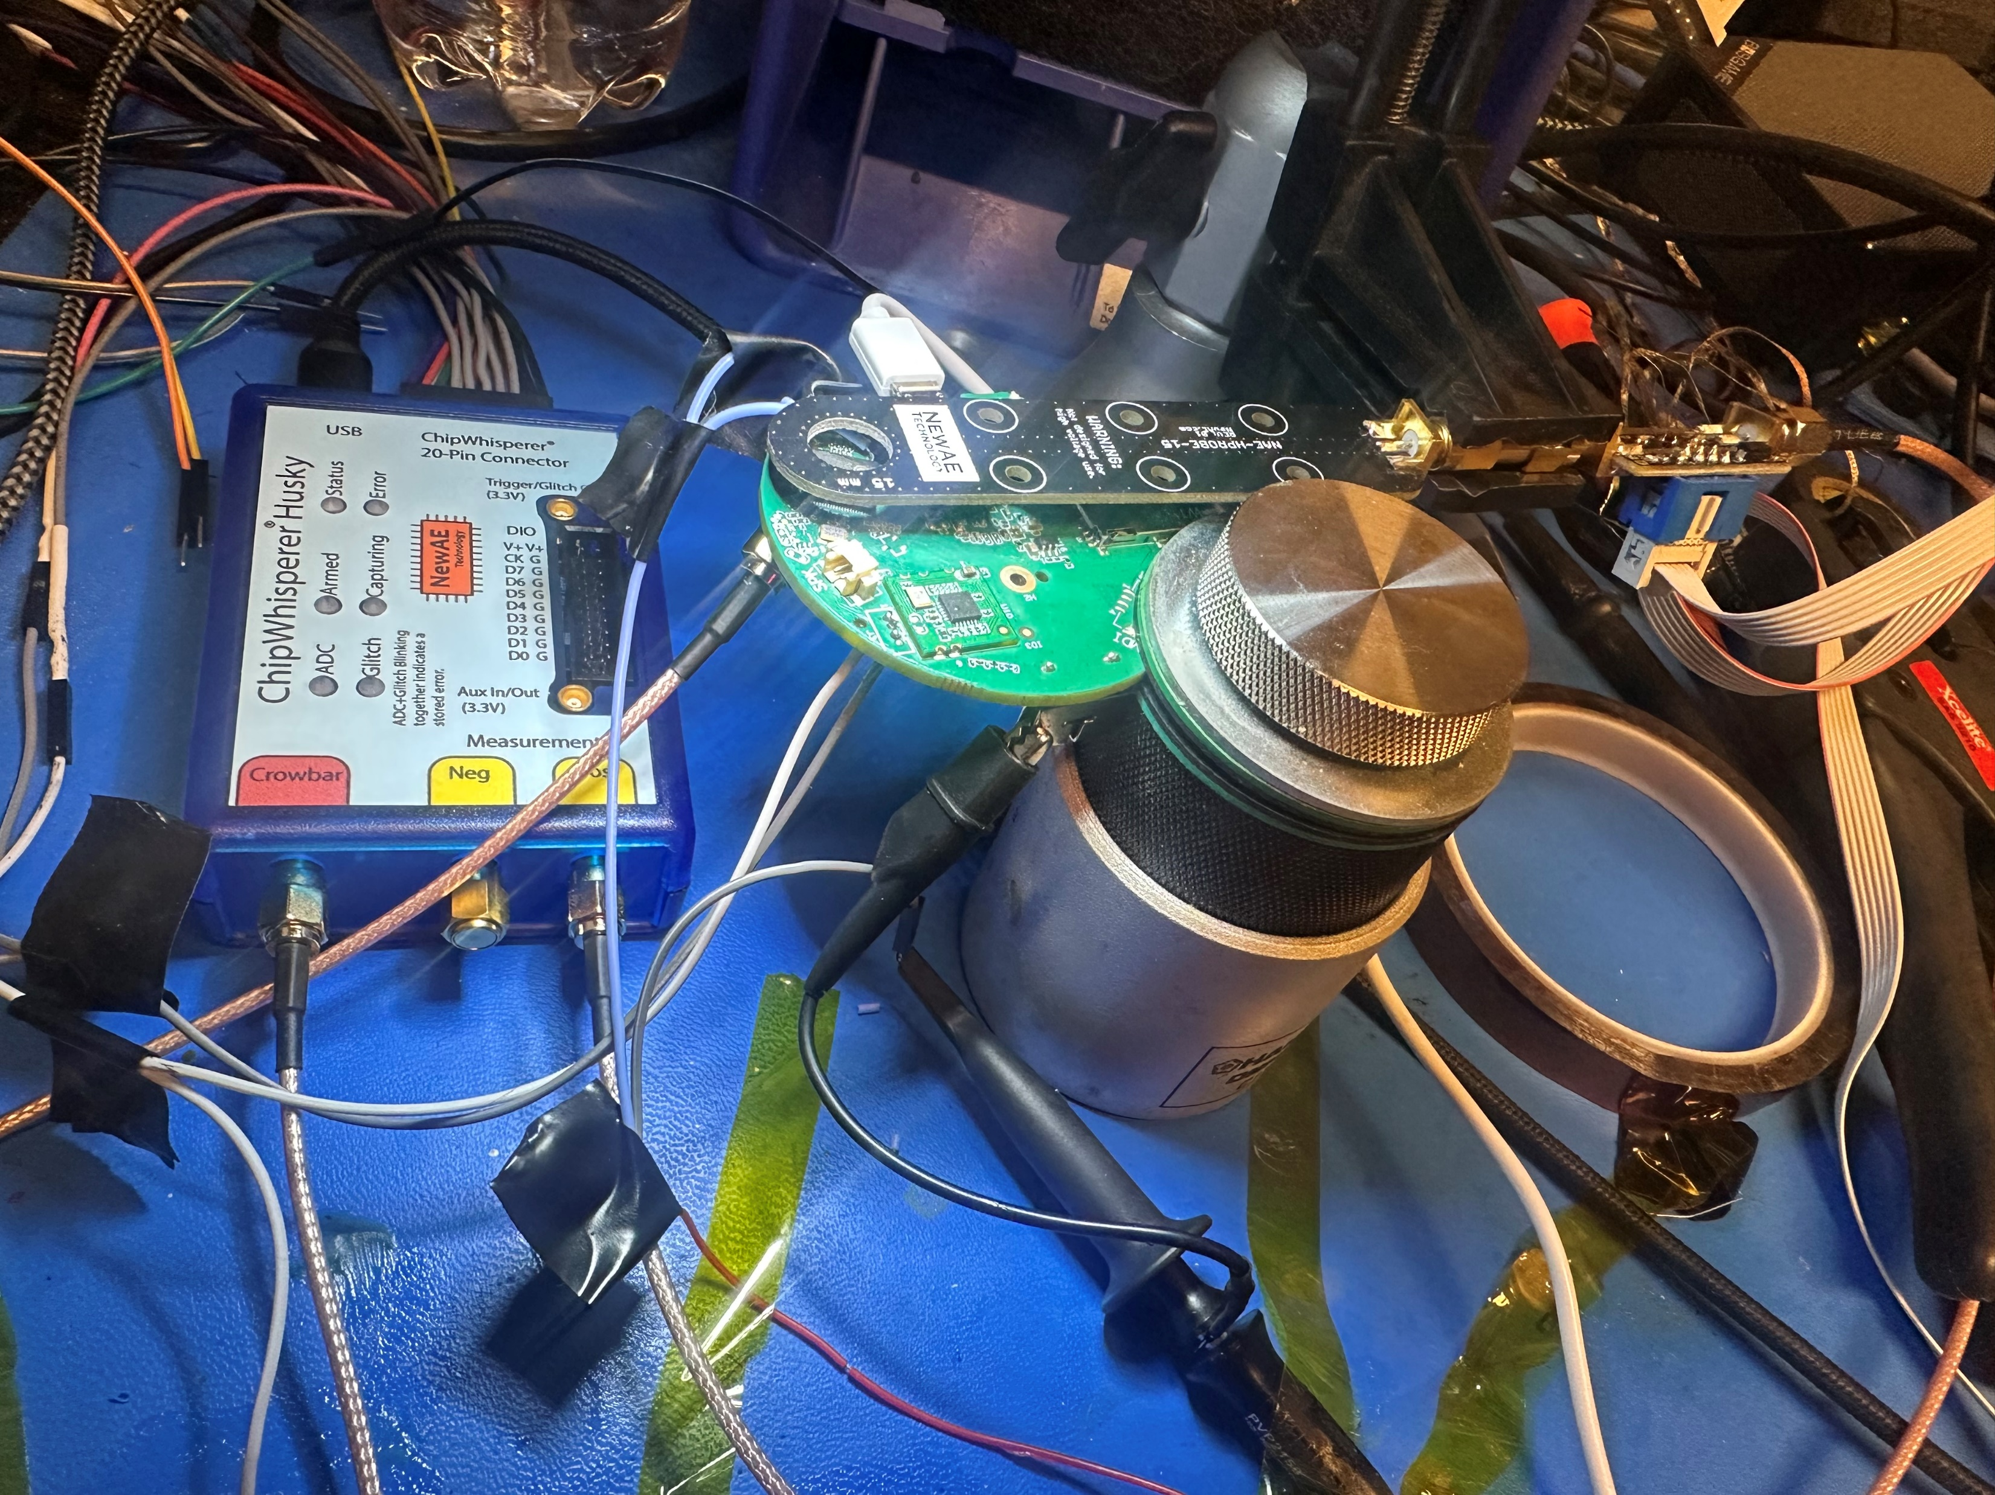

Slide 15
Other AES Issues
AES Modes
Oracle Attacks

Slide 16
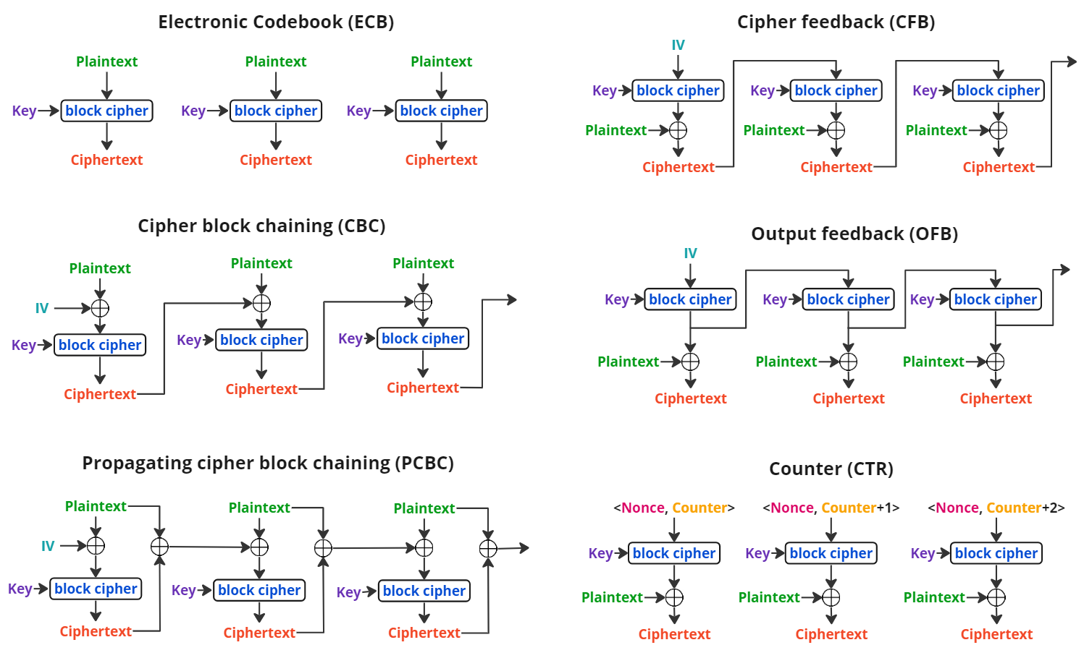
AES Modes

Slide 17

Plaintext

Slide 18

AES-ECB

Slide 19

AES-CBC
Try yourself: https://github.com/int3grate/security_week_ics_2024/

Slide 20

Oracle Attacks
Oracle primitive – hotter/colder
In practice:
Error messages
Response times
Response length
Types:
Compression
Padding

Slide 21
Compression Oracle Attacks
encrypt( compress( unknown_plaintext + attacker_choosen_text )) = ciphertext
Oracle: length( ciphertext )
Real world examples:
CRIME – SPDY, HTTPS, TLS
BREACH – HTTP compression over HTTPS
HTTP2 – hpack (special compression protocol to mitigate oracle attacks)
Mitigation: Don’t compress plaintext containing sensitive data

Slide 22
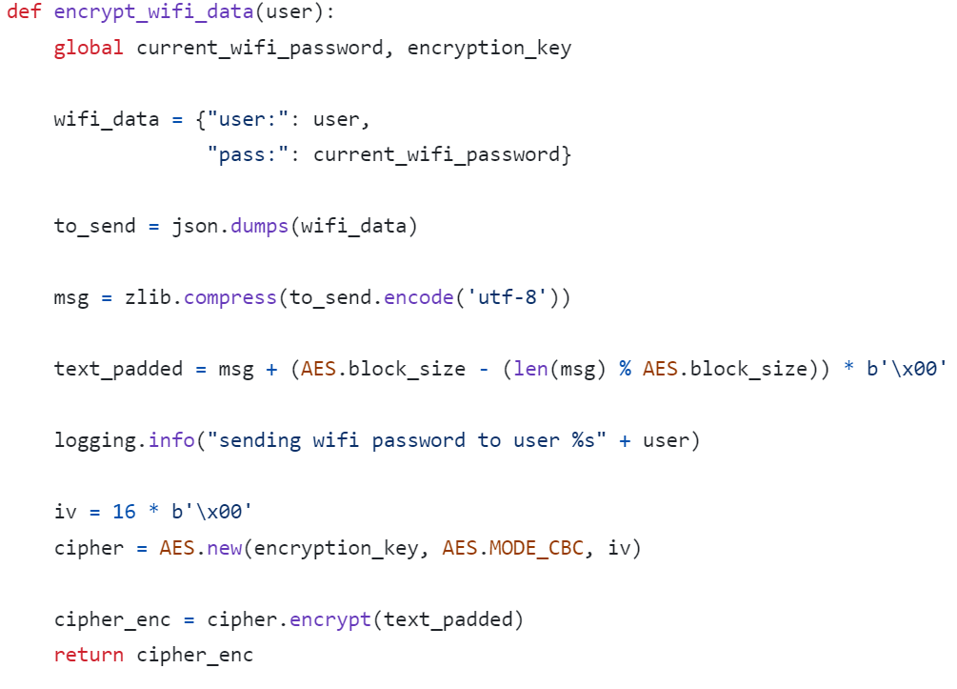
Compression Oracle Attacks
Vulnerable Function:
Try yourself: https://github.com/int3grate/security_week_ics_2024/

Slide 23
Padding Oracle Attack
PKCS#7
One byte padding
0x66 | 0x6C | 0x61 | 0x67 | 0x7B | 0x50 | 0x4B | 0x43 | 0x53 | 0x37 | 0x5F | 0x46 | 0x54 | 0x57 | 0x7D | 0x01
Two byte padding
0x66 | 0x6C | 0x61 | 0x67 | 0x7B | 0x50 | 0x4B | 0x43 | 0x53 | 0x37 | 0x5F | 0x46 | 0x54 | 0x57 | 0x02 | 0x02
Three byte padding
0x66 | 0x6C | 0x61 | 0x67 | 0x7B | 0x50 | 0x4B | 0x43 | 0x53 | 0x37 | 0x5F | 0x46 | 0x54 | 0x03 | 0x03 | 0x03
Block appended if no padding
0x10 | 0x10 | 0x10 | 0x10 | 0x10 | 0x10 | 0x10 | 0x10 | 0x10 | 0x10 | 0x10 | 0x10 | 0x10 | 0x10 | 0x10 | 0x10

Slide 24
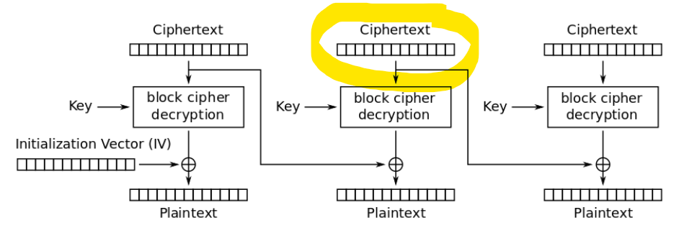
Padding Oracle Attack
XOR Properties
A ^ B = C
C ^ A = B
C ^ B = A

Slide 25
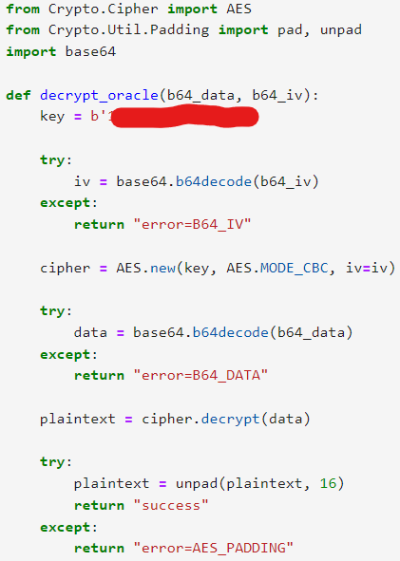
Padding Oracle Attack – Homework
Vulnerable Function:
Prevention: Include and use MAC or HMAC to verify encrypted message integrity before performing any decryption.
Try yourself: https://github.com/int3grate/security_week_ics_2024/

Slide 26
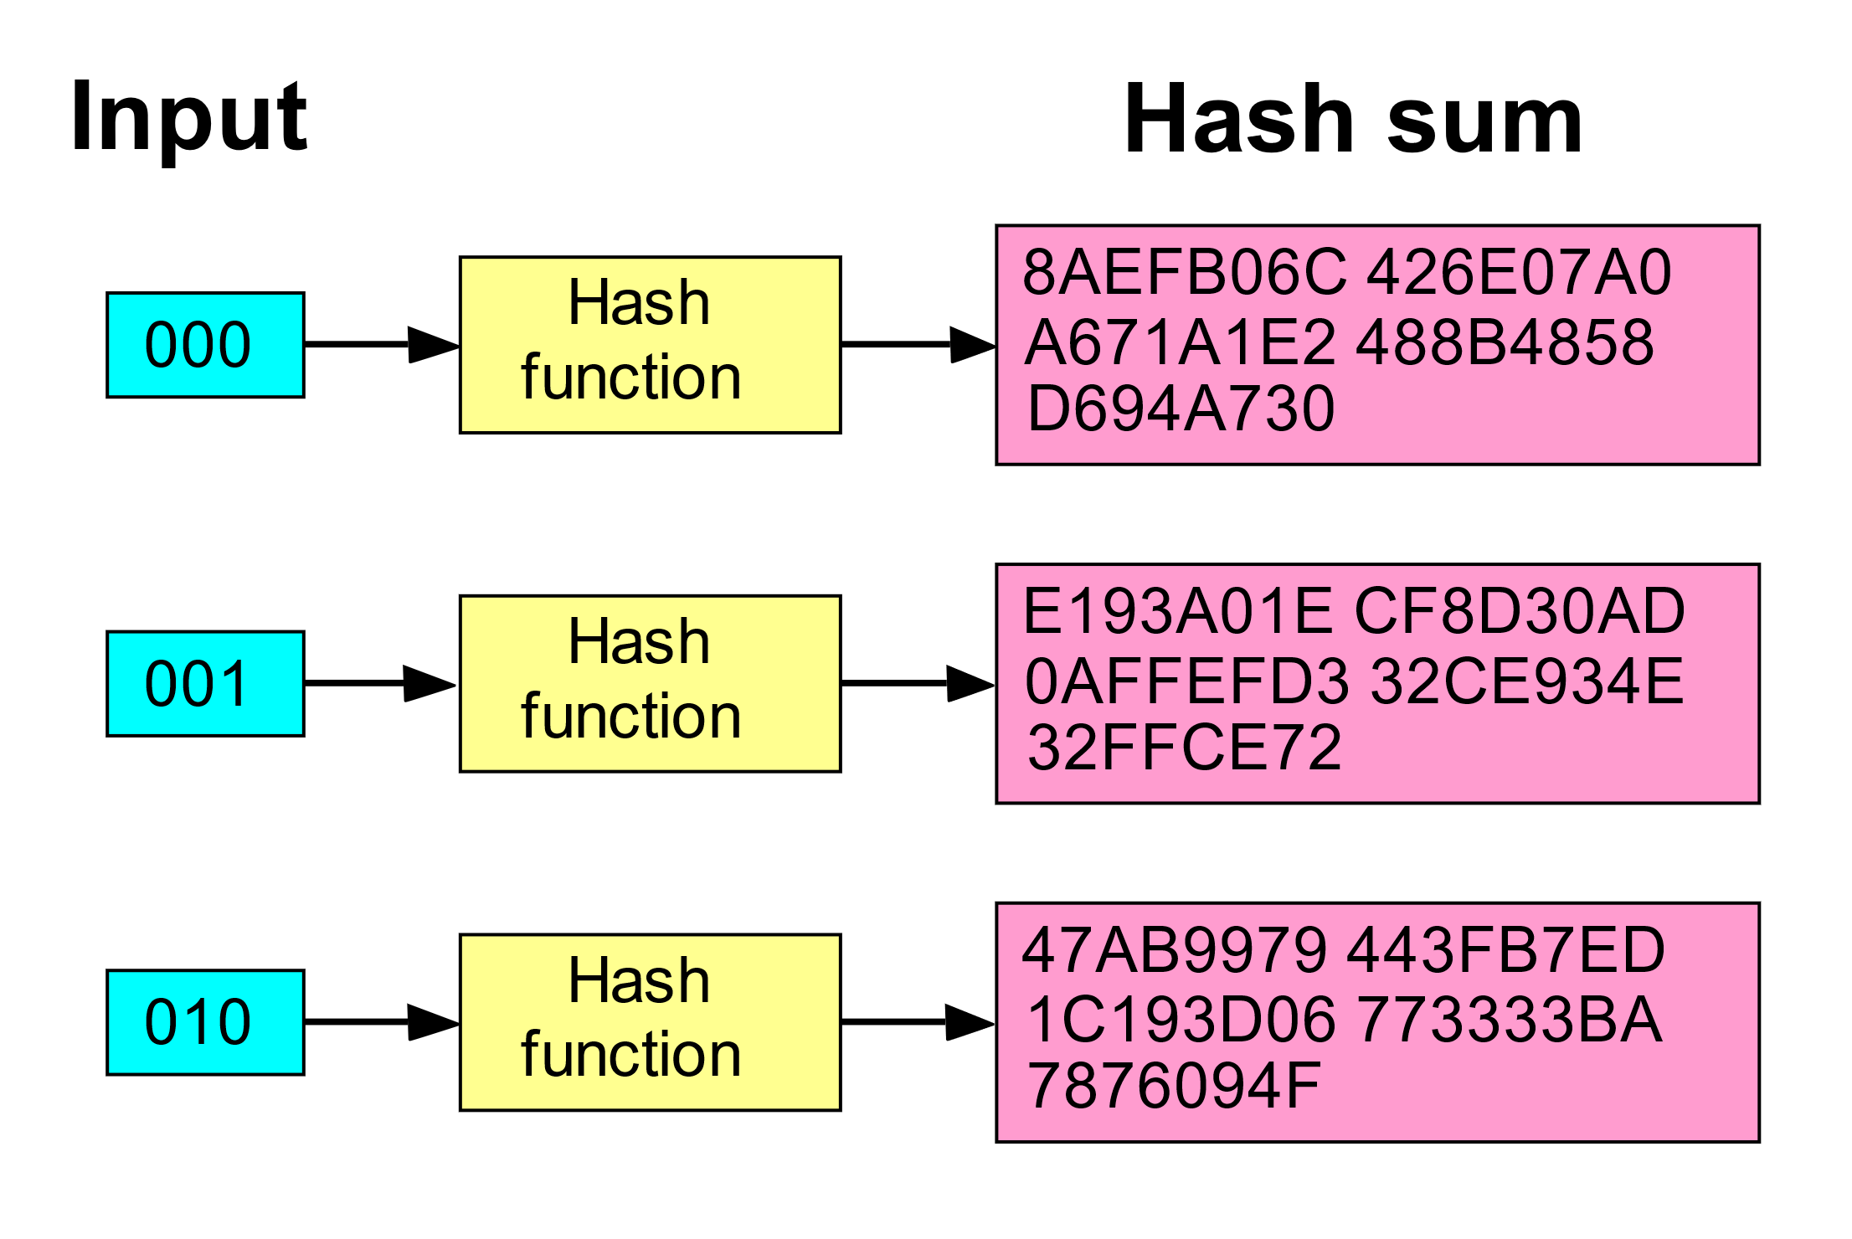
Cryptographic Hash Functions
Avalanche Effect (from Wikipedia):
Hashing Algorithms
MD5 (deprecated)
SHA1 (deprecated)
SHA2 (256, 512), truncated 224/384
SHA3
Input
Cryptographic Hash Function
Digest
“Hello World”
SHA256
a591a6d40bf420404a011733cfb7b190d62c65bf0bcda32b57b277d9ad9f146e

Slide 27
Cryptographic Hash Function Properties
Pre-image
Given a hash digest (the output of the hash function), it should be computationally infeasible to find any input message that produces that same digest.
Collision resistance
It should be computationally difficult to find two messages that produce the same digest.

Slide 28

Message Authentication Code (MAC)
Hacky McHackface
A
Alice
Bob
m
m’
m
Hacky McHackface
B
Alice
Bob
m
a = H(K,m)
m, a
m, a

Slide 29
MAC Attacks
Replay Attacks
Mitigations (in message):
Nonce
Timestamps
Sequence Number
Length Extension Attack
m = m₁ + m₂ + … + m_{k}
m’ = m₁ + … + m_{k} + m_{k+1}
Note: m’ needs to include padding and length field.
h(m’) = h’(h(m), h(m_{k+1})

Slide 30
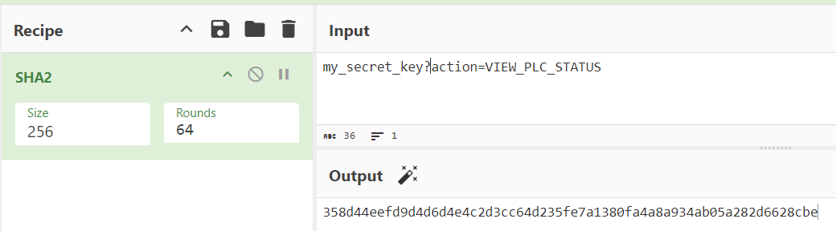
Length Extension Attack - PoC
Secret: my_secret_key (13 bytes)
Data: ?action=VIEW_PLC_STATUS

Slide 31
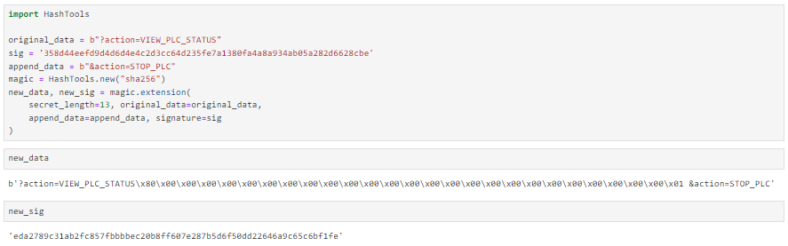
Length Extension Attack - PoC

Slide 32
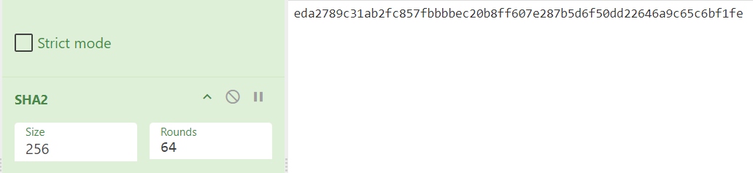
Length Extension Attack - PoC
Try yourself:
https://github.com/int3grate/security_week_ics_2024/

Slide 33
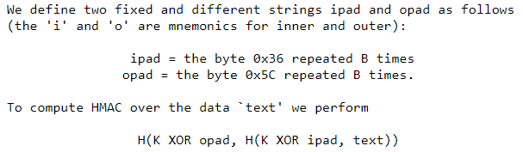
HMAC
HMAC – RFC 2104 (aka “Hash it again” approach)
K = key, text = plaintext, H = hash function
Protects against length extension, and potential key recovery attacks.

Slide 34
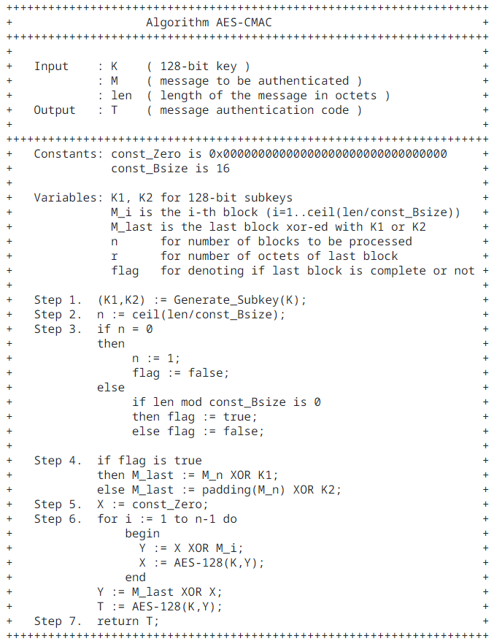
CMAC – RFC 4493

Slide 35
AES-GCM
Encrypt
Decrypt
T
AD
T
AD
AES-GCM
AES-GCM
P
P
C
C
P – Plaintext
AD – Associated Data
C – Ciphertext
T – Tag or MAC
Authenticated encryption with associated data (AEAD)

Slide 36
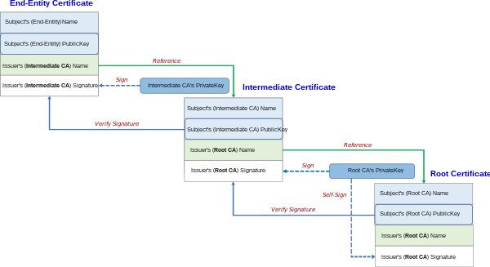
Asymmetric Encryption
RSA, DSA, ECDSA
Used for signing certificates, creating “chain of trust” used in PKI

Slide 37
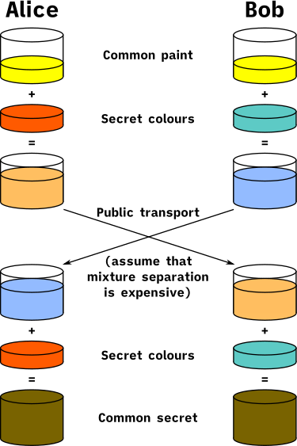
Key Exchange
DH (Diffie-Hellman)
DHE or ECDHE
Ephemeral
Perfect Forward Secrecy (PFS / FS)

Slide 38
Use TLS!!!
TLS 1.3 is latest version. As of April 2024, 1.1 and 1.2 are deprecated.
If using TLS 1.3, you can be sure that it won’t use any of the insecure mechanisms listed on previous slides.
TLS 1.3 uses a shorter handshake than previous TLS versions, making it faster than previous versions.
TLS 1.3 only uses ephemeral keys exchanged using Diffie Hellman. You can’t add a key to Wireshark to decrypt this traffic, but there are other was to reverse engineer protocols using TLS 1.3.

Slide 39
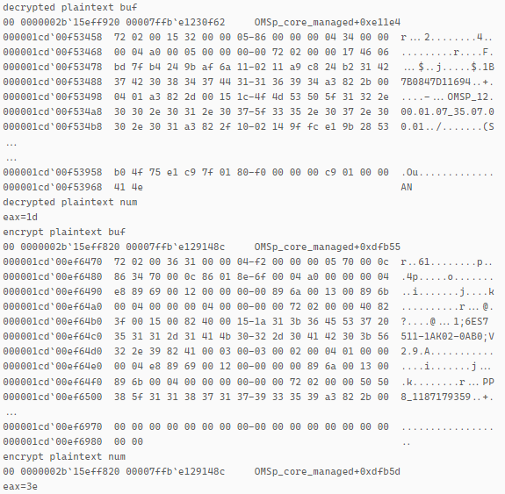
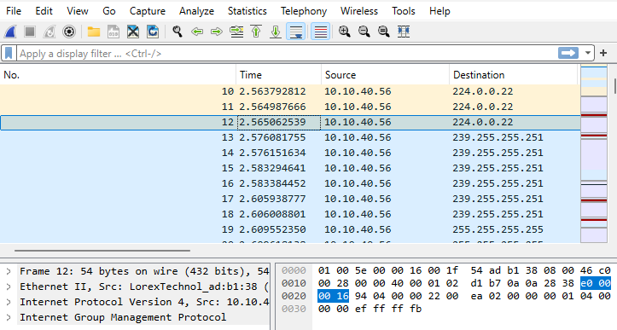
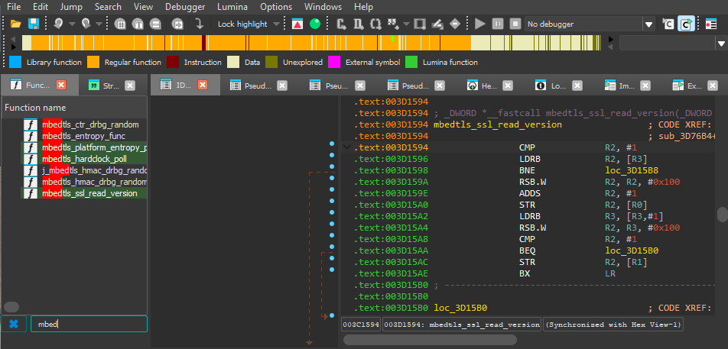
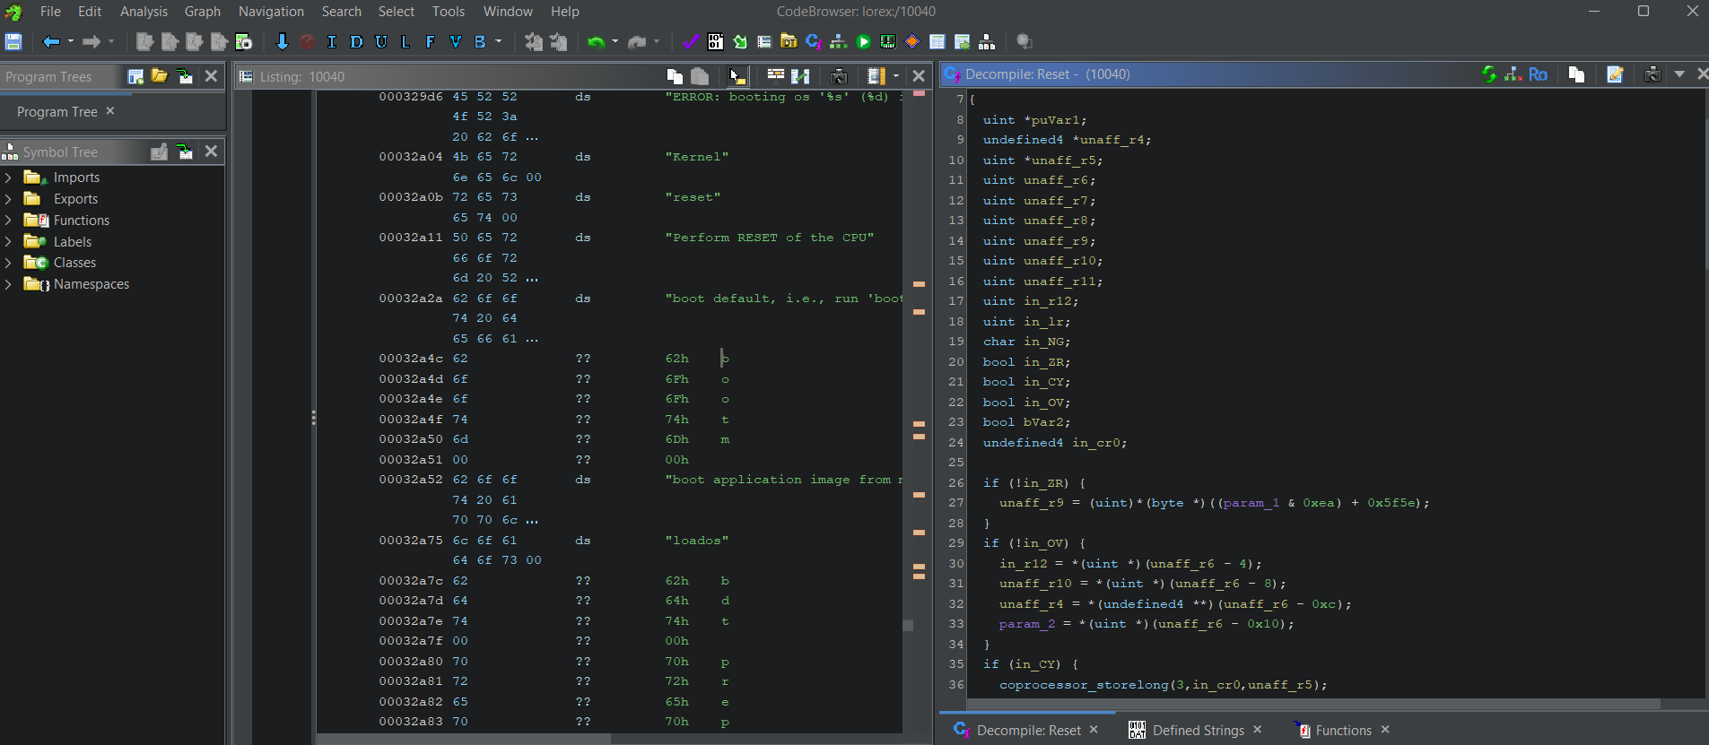
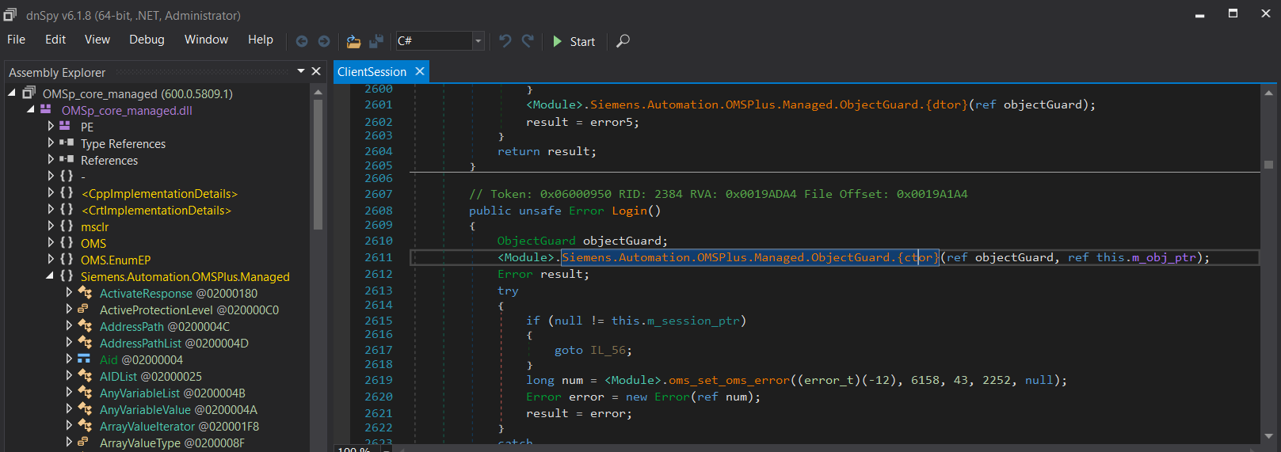
Case Studies – Reverse Engineering Tools
Tools:
Wireshark
Ghidra, IDA Pro
dnSpy (for .NET applications)
WinDBG

Slide 40
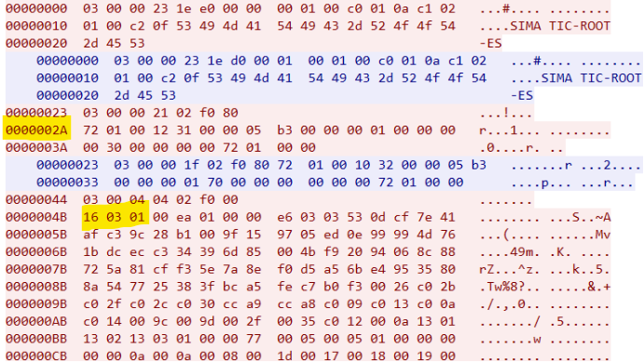
Identifying TLS – s7plus

Slide 41
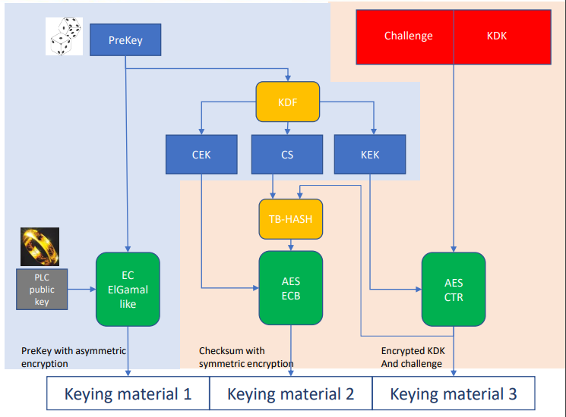
Siemens DIY Crypto
https://blog.viettelcybersecurity.com/security-wall-of-s7commplus-part-1/

Slide 42
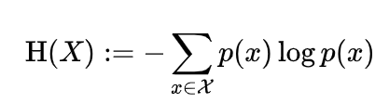

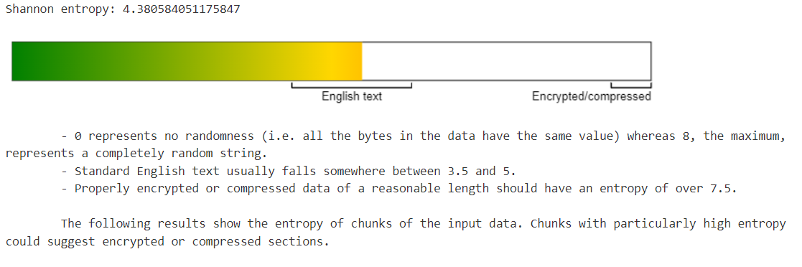
Entropy Calculations
The average amount of information contained in message

Slide 43
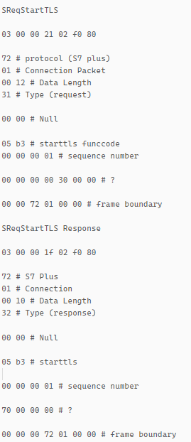
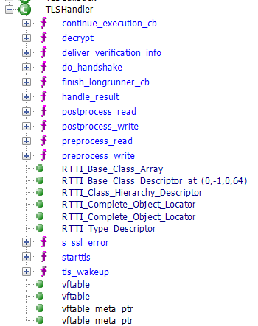
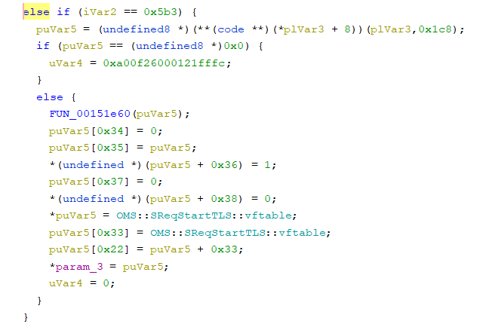
StartTLS

Slide 44
TLS Handshake (s7plus opportunistic / starttls TLS example)
Client Hello
Server Hello
Change Cipher Spec – 0x14 (for backwards compatibility)
0x17 – TLS Application Data

Slide 45
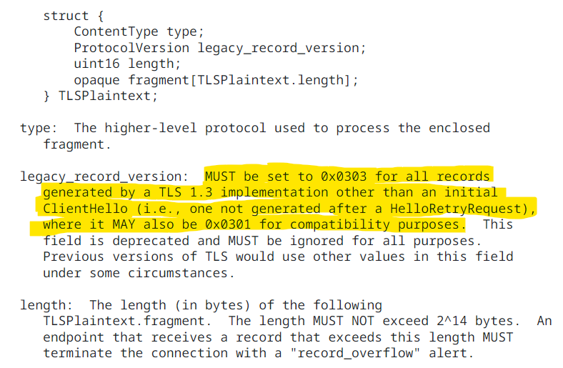
TLS Headers
Type: 0x16
Version: (TLS 1.0)
Length: 0x00ea (234)

Slide 46
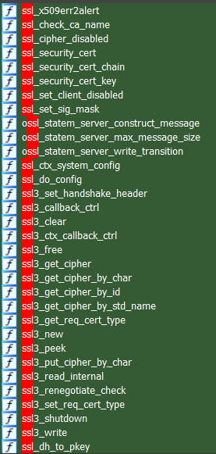
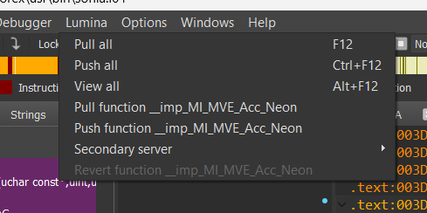
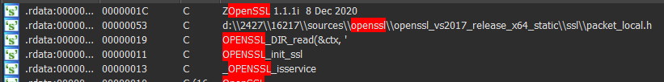
S7plus TLS – v17 and up

Slide 47
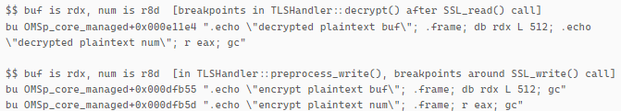
Reverse Engineering Protocols with TLS 1.3 – s7plus
My WinDBG Cheat Sheet:
https://github.com/int3grate/security_week_ics_2024/

Slide 48
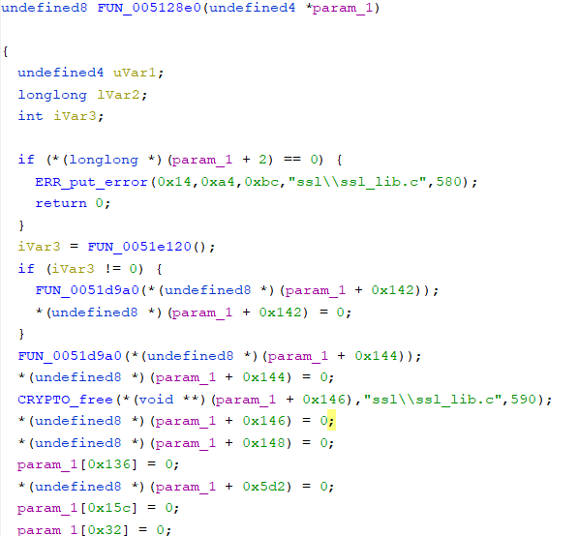
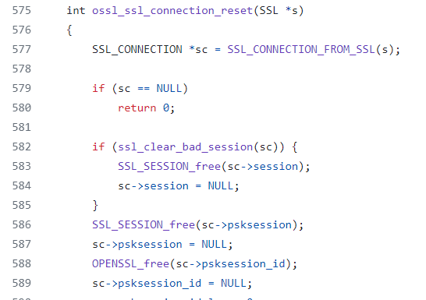
Reverse Engineering s7plus

Slide 49
WinDBG Output

Slide 50
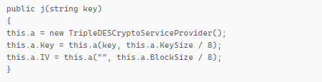
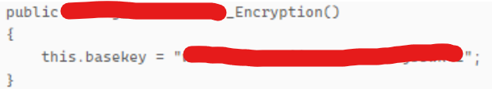
Deprecated Algorithms
NIST has deprecated DES and 3DES. Use AES instead.
Remember: SHA1 and MD5 are deprecated also, used SHA256/512. RSA < 2048 is also deprecated.
Avoid hardcoded keys if possible.

Slide 51
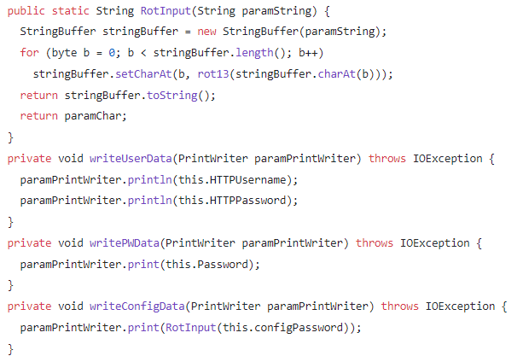
Password Storage (Client Side)

Slide 52
Password Storage (Server Side)
Don’t store passwords, store their salted and hashed digests (using a cryptographically sound RNG source, and FIPS compliant hash algorithm).
Salted SHA256 password hash: rnd_str + ‘$’ + SHA256(rnd_str+password)
Better yet, use an algorithm designed for storing passwords that is FIPS compliant.
Argon2id
scrypt
bcrypt
https://cheatsheetseries.owasp.org/cheatsheets/Password_Storage_Cheat_Sheet.html

Slide 53



Hardcoded Keys
https://medium.com/tenable-techblog/inside-simplisafe-alarm-system-291a8c3e4d89

Slide 54

Improper Password Authentication
https://medium.com/tenable-techblog/examining-crypto-and-bypassing-authentication-in-schneider-electric-plcs-m340-m580-f37cf9f3ff34

Slide 55

Authentication Bypass
CHAP (rfc1994)
HTTP Digest Auth
Server
Client
Salted Hash
Salt, Challenge Value
Password
Encrypted Challenge Value (using salted hash as shared secret)

Slide 56
Conclusion
Use a popular, well supported cryptographic library in your projects rather than writing your own cryptographic functions. If possible, leave it as a shared library.
TLS 1.3 with certificate authentication is a complete solution for integrity, authentication, and confidentiality.
Don’t use deprecated cryptographic functions.
Encoding / obfuscation is not adequate for password protection.
Use HMAC rather than MAC.
Don’t assume hard coded encryption keys in hardware can’t be recovered.
Don’t use default passwords, and store them properly using salted hashes.
Don’t re-invent the wheel, look for prior work, and RFCs when designing new security mechanisms.
Have experts review you cryptographic implementations.

Slide 57
Password Authentication Best Practices – End Users
Ideally random user IDs to prevent attackers guessing.
Use different authentication solution for remote access than what is used internally (LDAP, AD, etc…). Ideally something designed for this purpose that uses 2FA.
Passwords should be at least 8 characters. OWASP recommends using a password “strength” meter rather than complexity requirements which can result in more predictable passwords.
https://github.com/zxcvbn-ts/zxcvbn
https://cheatsheetseries.owasp.org/cheatsheets/Authentication_Cheat_Sheet.html

Slide 58
Questions?
nmiles@tenable.com
https://medium.com/@nmiles_19125
https://www.linkedin.com/in/nicholas-miles-7a6b1b34

